Slide 1
E-Collection API
December 19, 2025

Slide 2
What is e-Collection
E Collection product facilitates clients to get the funds in Virtual Account Number from payer through inward transactions like NEFT, RTGS, UPI, IMPS & FT in there account
The product focusses on Corporates/ Schools / Micro Finance / Loan Disbursing Companies / Government Entities (utilities payment) with large vendor/consumer database needing regularly to remit money through electronic modes for e.g. B2B/ B2C/ channel partners/ utility service provider companies.
This is a flexible and customizable solution which expedites the collections process for clients and provides them with timely MIS.

Slide 3
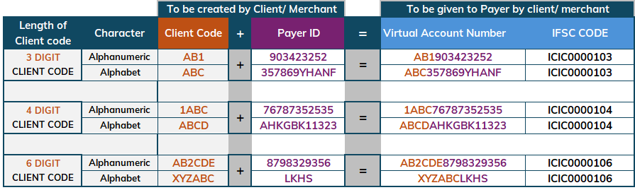
Basics of Virtual ID creation
Virtual Acc.No./ ID is the combination of CLIENT CODE + PAYER ID
Client Code – alphabets / alphanumeric and it can be of 3 or 4 or 6 characters. Numeric Client code is not allowed.
IFSC Code will be ICIC0000103, ICIC0000104 or ICIC000106 basis client code character length
Virtual Acc.No./ ID will act as an alias for the Merchant’s /Corporate Current Account Number
Payer id can be anything. Payer’s mobile number OR Invoice no. OR Challan no. OR any random number of client’s/ merchant’s choice. Client code & IFSC will be fixed value
EXAMPLE
Note:
As per client code length, IFSC to be given to payer by Client. Branch IFSC is not applicable.
Only one mentioned in table is applicable

Slide 4







Pictorial Representation of How E-Collection Works
Payer 1
Payer 2
Payer 3
2
Merchant will assign/share Virtual id’s to Payers
Along with IFSC
Payer will login to his/her Netbanking or UPI App
To make Payment
1
NEFT, RTGS, IMPS, UPI & FT Supported
Virtual A/c no: APMC129920373 IFSC: ICIC0000106
Virtual A/c no.: APMC12001234
IFSC: ICIC0000106
Virtual A/c No.: APMC12BBU123
IFSC: ICIC0000106
E.g., Merchant E Collection client Code is APMC12 (6 digit)
3
4
5
Once Funds are Credited in Merchant Current Account
MIS API will be hit on Client’s ERP URL
Client will check MIS and update their database
Bank will Verify the Client Code and if exist for E-Collection then Credit Funds to Client’s Current Account
Note: Virtual Account number assigned is Dummy account number i.e. Beneficiary account number for Payer to make Payments.
- Client to share ERP URL in https where bank will hit MIS request.
- IFSC Code and Client code will be fixed value as shown above.

Slide 5








Features & Benefits of e-Collection
Reconciliation made easy for Corporates
Multi payment modes for receiving payment
Enhanced reports on Credit Information
Choice of receiving Bank Validated transactions
MIS available in text, excel and xml formats
Customized MIS over email, Host to Host or API channels
MIS available in pre defined frequency and consolidated EOD MIS

Slide 6





MSG Hold API- Features & Benefits
MSG Hold API enables clients to validate inward transactions in real-time before crediting their account and simplifies reconciliation at their end
Real-time decision making on inward transactions
Time-Efficient reconciliation
Only accepted transactions reflect in MIS and Account Statement
View final status of transactions with Credit Confirmation API
z
Set default deemed action (Accept/Reject)
Smooth, hassle free & quick transaction experience
Faster Return to Payers

Slide 7
Sample Request & Response Packets
eCollection Validation API: To validate the transaction before crediting
2. eCollection MIS posting API: To send the confirmation to client for credit
Standard Request and Response:
“ClientCode": “REL",
"VirtualAccountNumber": “REL9834191192",
"Mode":"RTGS",
"UTR": "CITIR52011986928310711",
"SenderRemark":"Testing",
"ClientAccountNo": “XXX9834191192",
"Amount": "7877777.00",
"PayerName": “Jeet Raul",
"PayerAccNumber": "XXX8429324",
"PayerBankIFSC": "CITI0100000",
"PayerPaymentDate": "20200731 ",
"BankInternalTransactionNumber": "REQ20213000001"
Response:
"AcceptOrReject": “N",
"Message": “Reject",
"Code": "12"
Standard Request and Response:
“ClientCode": “REL",
"VirtualAccountNumber": “REL9834191192",
"Mode":"RTGS",
"UTR": "CITIR52011986928310711",
"SenderRemark":"Testing",
"ClientAccountNo": “XXX9834191192",
"Amount": "7877777.00",
"PayerName": “Jeet Raul",
"PayerAccNumber": "XXX8429324",
"PayerBankIFSC": "CITI0100000",
"PayerPaymentDate": "20200731 ",
"BankInternalTransactionNumber": "REQ20213000001"
Response:
"Response":"Success","Code":"11"}
{"Response": "Duplicate UTR", "Code": "06"
Code | Accept Or Reject | Message
11 | Y | Accept
12 | N | Reject
Code | Response
11 | Success
06 | Duplicate UTR

Slide 8
MSG Hold API- Response time from client’s end
For MSG Hold API, if client’s ERP is unavailable due to some reason, then bank will not do any retry.
Bank will wait on client’s MSG HOLD URL for below mentioned timelines. If bank does not get any response in these timelines then it will consider Deemed Accept/Deemed Reject scenario according to the configuration happened at bank end -
For UPI: 5 secs, For IMPS: 5 secs, For RTGS: 10 secs, For NEFT: 10 secs, For FT: 15 secs
Deemed Accept or Deemed Reject scenario.
Any one deemed scenario needs to be selected by client at the time of onboarding. –
Deemed Accept: By default bank will credit funds to client’s account if there is no response from client for MSG Hold API.
Deemed Reject: Bank will refund back to payer if there is no response from client for MSG Hold API.

Slide 9
MIS Posting API – Retry attempts
Bank will re-try for 3 times after every 6 mins for all payment modes if there is no response from client.
Bank will wait for 6 minutes to get reply from client
In response, client needs to send “Success” this means they have received & updated MIS at their end
If client received same MIS twice, then send “Duplicate UTR” as response
Note: If Client do not get any Request from Bank, then ask them send email to SM along with transaction details. Bank will manually push the transaction to client for updation.

Slide 10
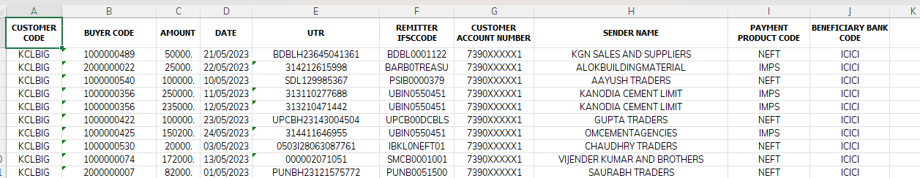
MIS FORMAT OVER EMAIL

Slide 11
Narration in Account Statement
Payment Mode | Format of Narration in Account Statement | Sample narration
NEFT | NEFT-UTR-VID-Sender account name-Sender account no | NEFT-IDFBH21201361579-RILDPP0008-JINDAL POLY-53784
RTGS | RTGS-UTR-VID-Sender Name | RTGS-HDFCR52021072053865784-RILDLB00080178-KHURA
IMPS | MMT/IMPS/RRN/VID/Sender account name/Sender to Receiver Info | MMT/IMPS/120109506195/DSAW822095608/DEVENDRASA/fee
UPI | UPI/RRN/VID/Payment remarks/payer UPI ID/Payer Bank IFSC Code | UPI/120109003616/DSAW63809446/2/6380944206@upi/l
CIB | INF/INFT/Ref no/VID/remarks/Sender account name | INF/INFT/024273862311/GECM116878/GEMSEC/SOM
RIB | BIL/ECOL/Ref no/VID/remarks | BIL/ECOL/000144169057/GECM32873/against caution

Slide 12
Steps for making payment to Virtual id using UPI Mode
STEP 1 : Payers needs to login to their UPI App (PSP App) for making payments using Virtual ID
STEP 2 : Payer needs to select the send money to Bank Account Option
STEP 3 : Enter the Virtual ID and IFSC Code
STEP 4 : Enter the Amount and UPI Pin to complete the transaction
Important Points:
If Virtual ID is correct, the money is credited to the corporate’s account, else the transaction is rejected.
Application generated MIS and the same is sent to the corporate client
Note: Account Managers can access the MIS using Profunds (bank’s internal system)
Payer Details is visible in the account statement narration for easy reconciliation

Slide 13
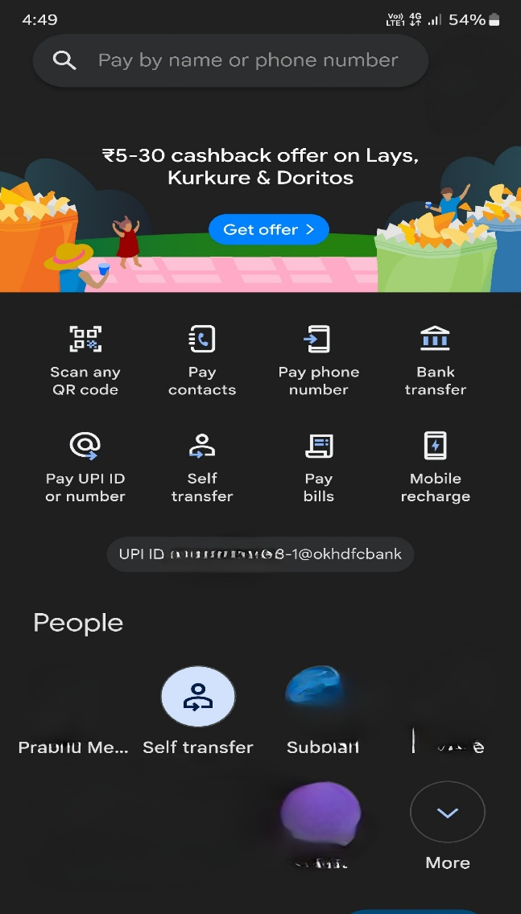
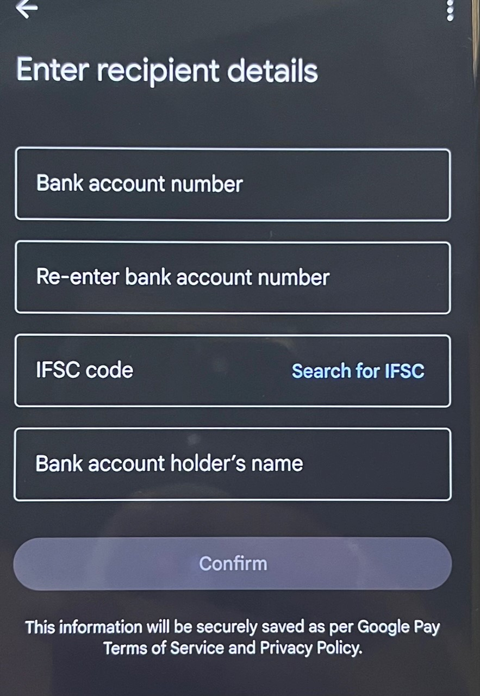
UPI transaction via Gpay (PSP)
1. Open Google pay app→ Select “Bank Transfer” option→ Enter Bank account number as Virtual ID and IFSC code of e-Collection
1
2
13

Slide 14
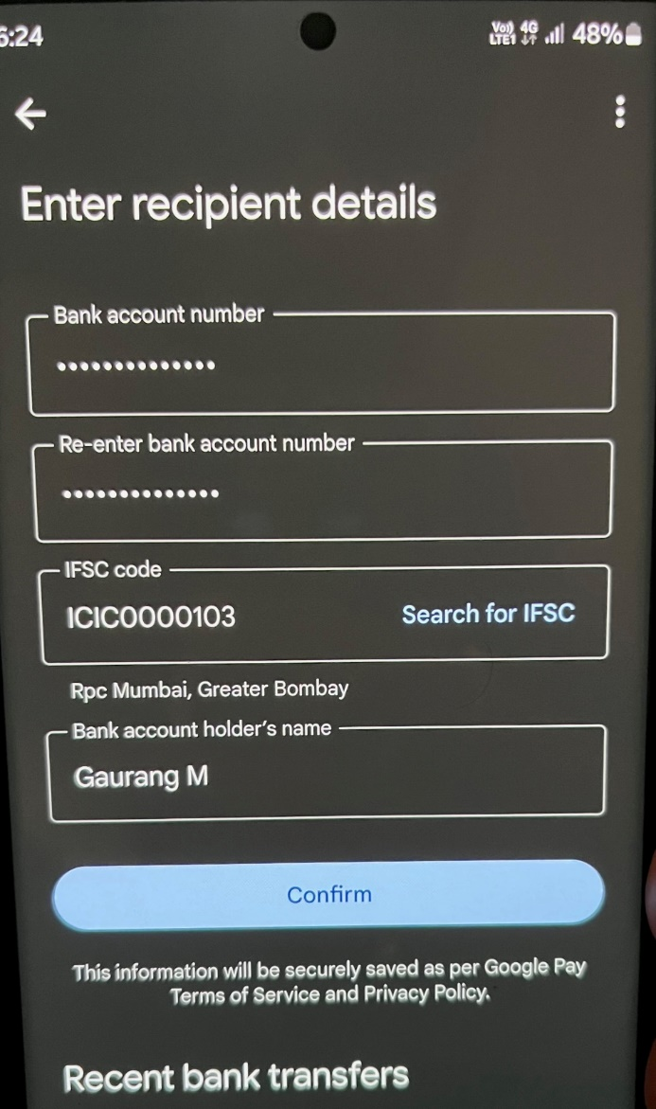
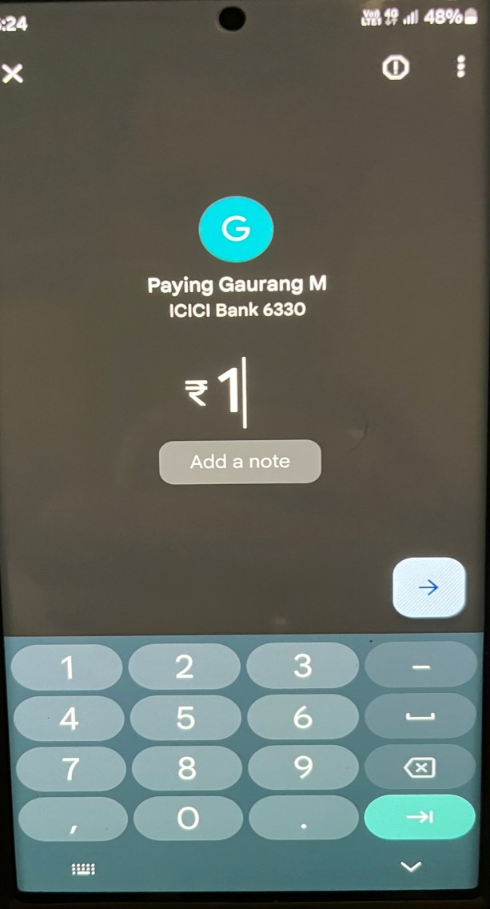
…UPI transaction via Gpay (PSP)
2. Enter Bank account number as Virtual ID and IFSC code of e-Collection → Enter Amount, If payer wants to add Remarks for transaction, then click on Add a note→ Then click on Arrow→ Enter Pin and Make payment

Slide 15
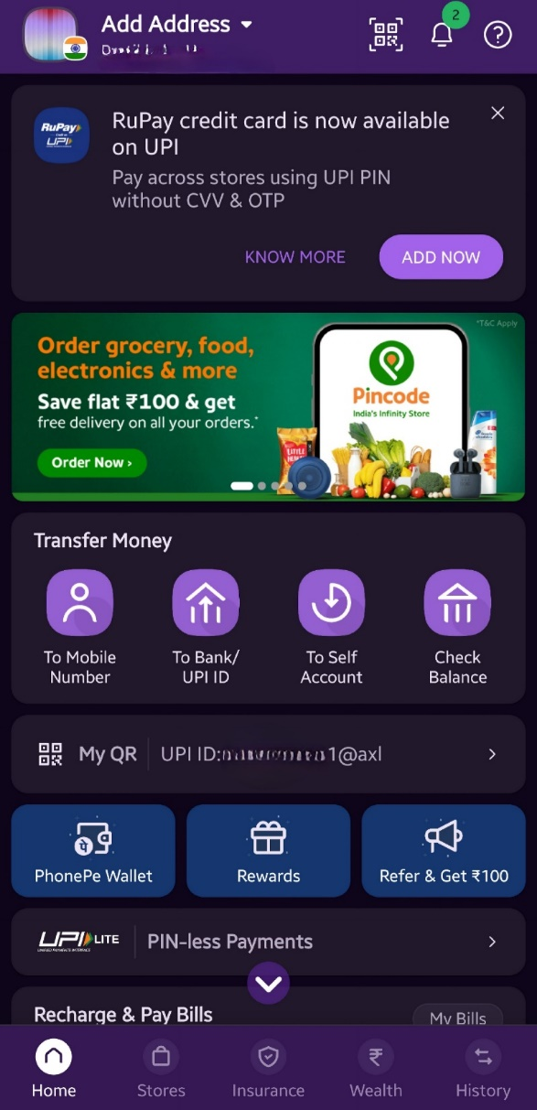
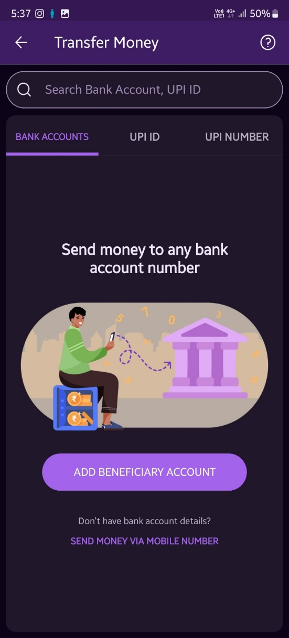
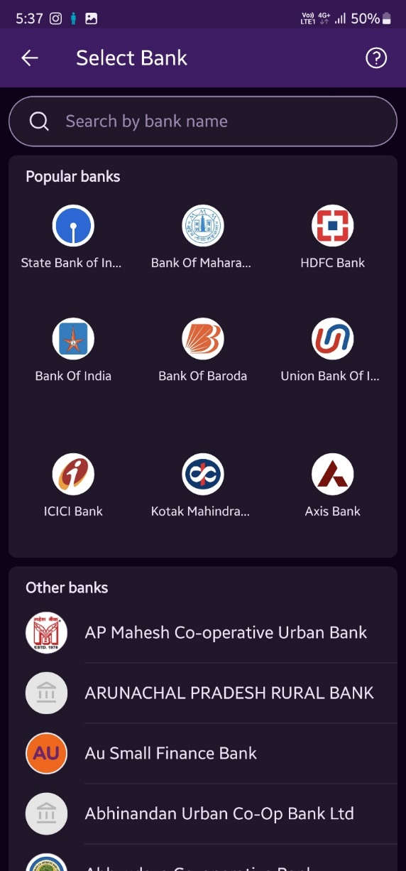
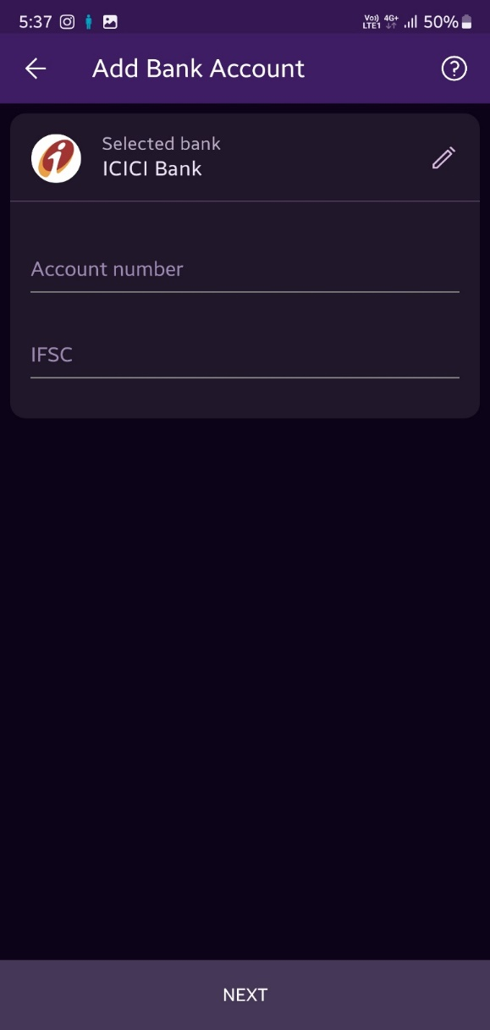
UPI transaction via Phonepe (PSP)
Open phone pay App→ Click on To Bank/UPI Id option→ Add Beneficiary Account→ Select Bank as ICICI Bank→ Enter Virtual ID in Account number field and IFSC of E-collection→ Click next Enter Amount, PIN and make payment
1
2
3
4

Slide 16
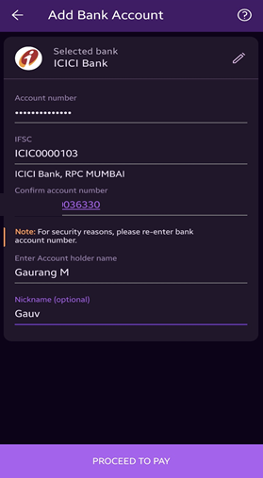
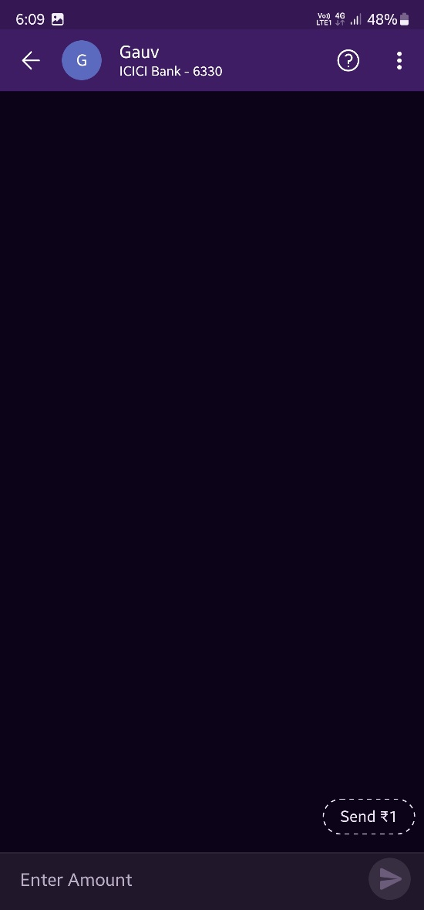
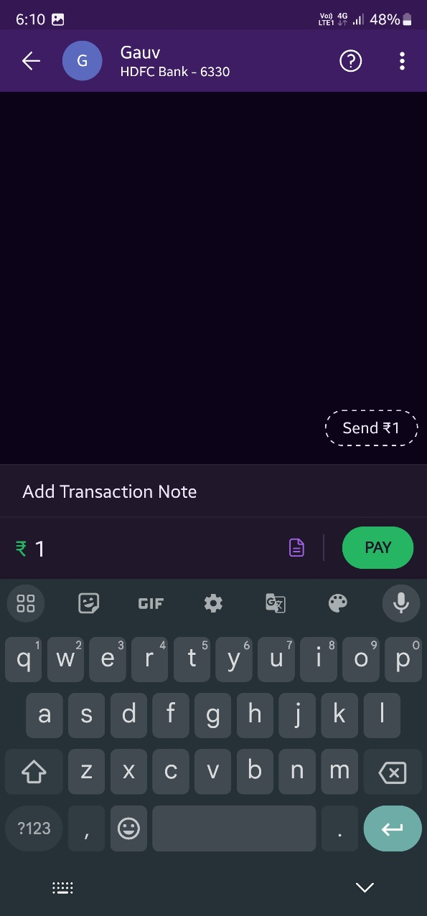
…UPI transaction via Phonepe (PSP)
Enter Bank account details→ Click on Proceed to Pay→ Enter Amount → If payer wants to send Remarks, click on Add Transaction Note→ Click Pay button
5
6
7

Slide 17
Technical Pre-requisite
1. *CA signed Public Certificate from client, preferable 4096 bit certificate
2. Client code and Coding language of client’s ERP ( mention in text file)
3. Client’s ERP URL (mention in text file)
We need 2 URLs for MSG Hold API and MIS Posting API.
It should be of "https://" based
*Client can procure / purchase certificate from Go daddy, Geo Trust, Amazon AWS, Digicert, Entrust etc…These are the vendors who provide certificates

Slide 18
Thank you

